Slide 1

Balloons
&
Ribbons
Tamim Bin Zakir
Farhana Meem
MD. Abir Ahsan
Murtoza Ahmed

Slide 2

Types of Venue
Convention Hall
Party Center
Resort
Restaurant
Art Exhibition
Auditorium

Slide 3
What is a vendor?
Decorator
Catering
Photographer
Choreographer
Anchor/Host
DJ
Makeup Artist

Slide 4
Event Analysis
Analysis the event’s need for venue
Indoor or Outdoor Event?
Audience Capacity
How long do we need the venue for, including setup and takedown?
Good Transport Access

Slide 5
Project Features
After careful analysis of event’s requirements:
Find & investigate your desired venue and vendors
Check venue suitability(dimensions, indoor/outdoor event)
Check if the selected venue is appealing to all participants(lighting, temperature control, protection from wind/rain if outdoor event)
Other facilities like telecommunication, food service, meeting rooms, changing areas.
Cost friendly.
If all conditions are met:
Communicate with them instantly through our website
Confirm/Book over the phone

Slide 6

Our Unique Features
Directly negotiation.
No need to contact venue managers.
Routinely updated details of venue. Get the absolute best deals.
Our own array of vendors such as Catering, Event Management Photography House.

Slide 7
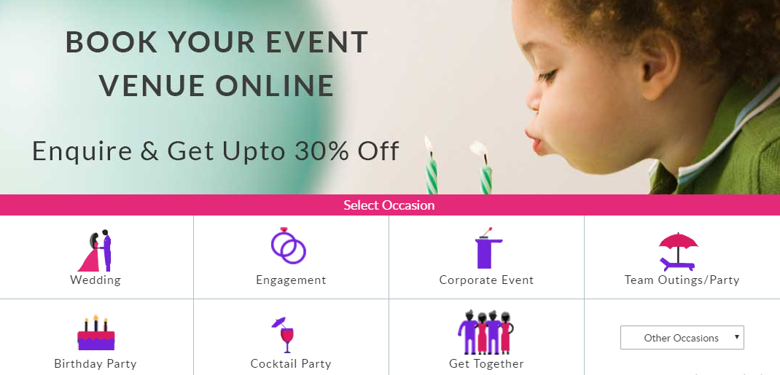

Slide 8
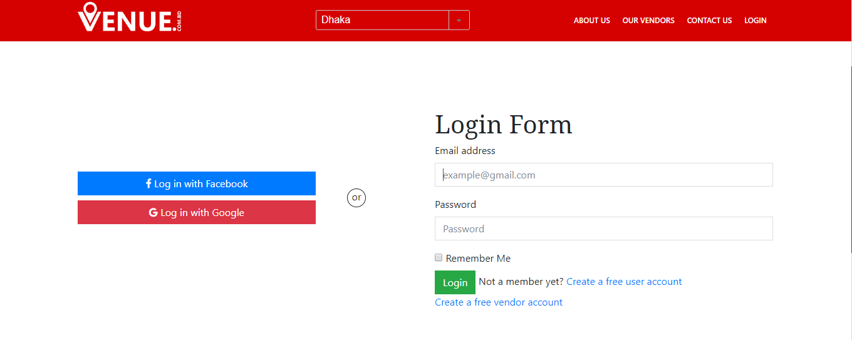
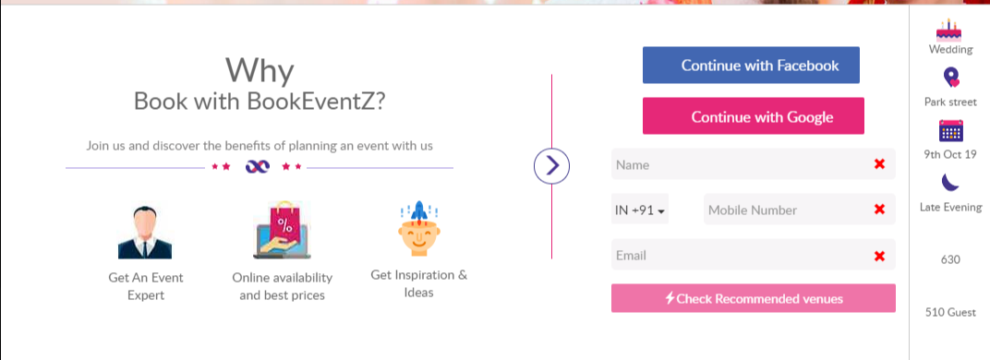

Slide 9
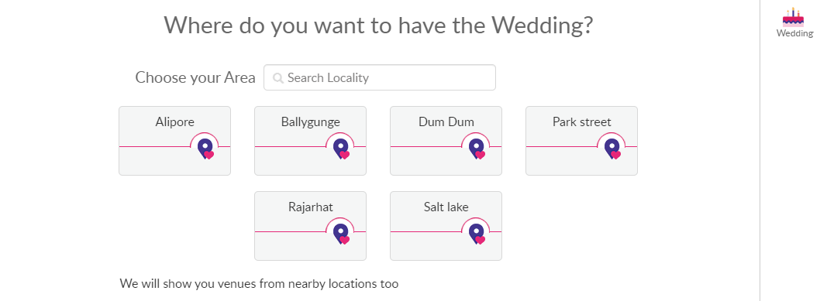
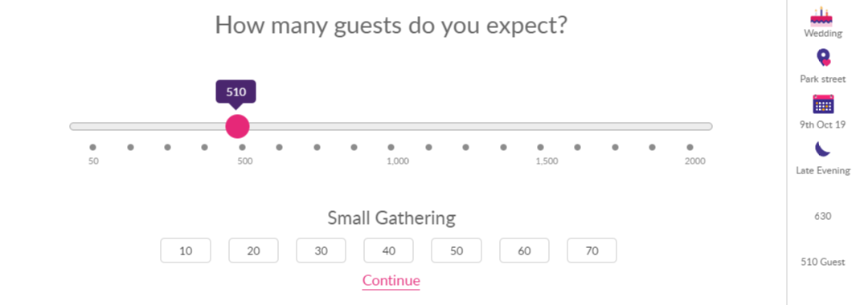
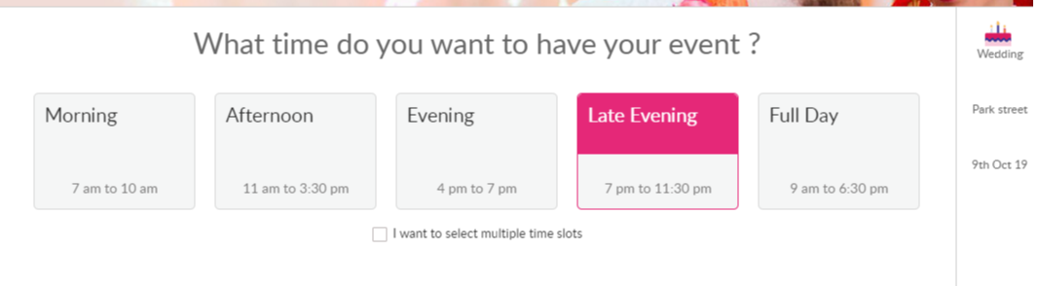

Slide 10
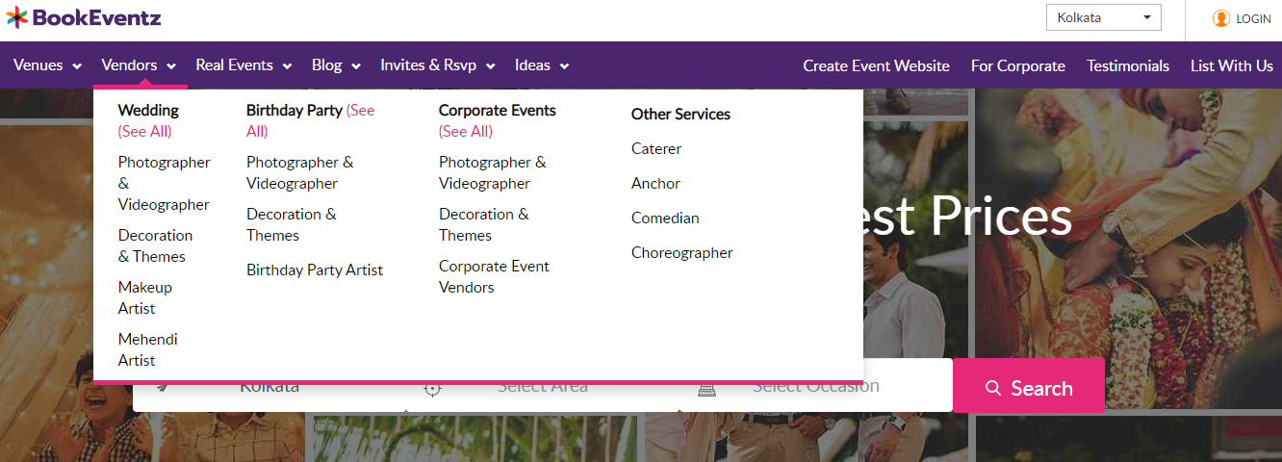
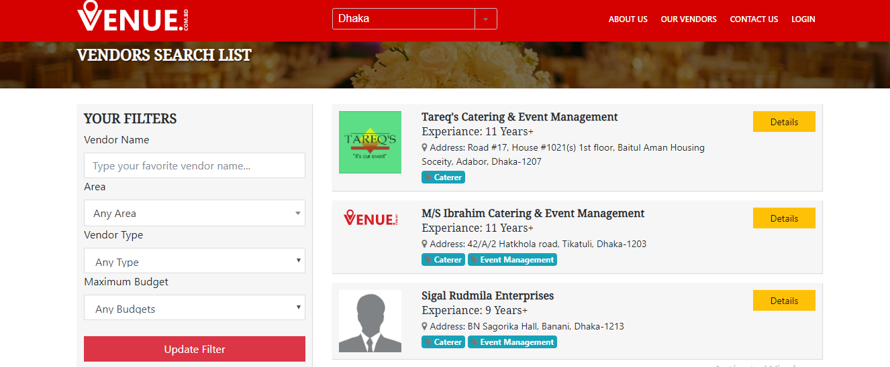

Slide 11





Feature | venuu.com | venue.combd | BookEventz | Our Proposed Project
Wide Range of Venues
Multiple Vendors
Hiring through venue manager
Direct Confirmation
Social Gathering
Corporate Party
Budget Demonstration
Routinely updated venue/vendor details
Free time slot

Slide 12
Thank You!

